Slide 1
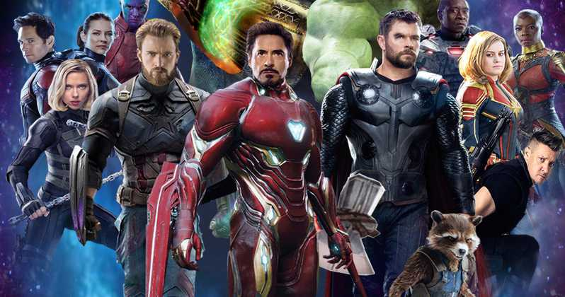
Interactive MCU Battle Map
By Aaron Lewis

Slide 2

Problem
As the scope of the MCU Movies increases, it is becoming harder and harder to keep track of all of the different events
There are details about the location of the films that gets lost over time if you haven’t seen it recently, and remembering the location and context can help jog your memory and see how the events of a movie fit into the broader context of the MCU

Slide 3
Solution
Create a map that shows the location of every major battle on earth throughout all of the movies up to infinity war
Display information about different movies depending on where the mouse hovers, including title, location, and description

Slide 4
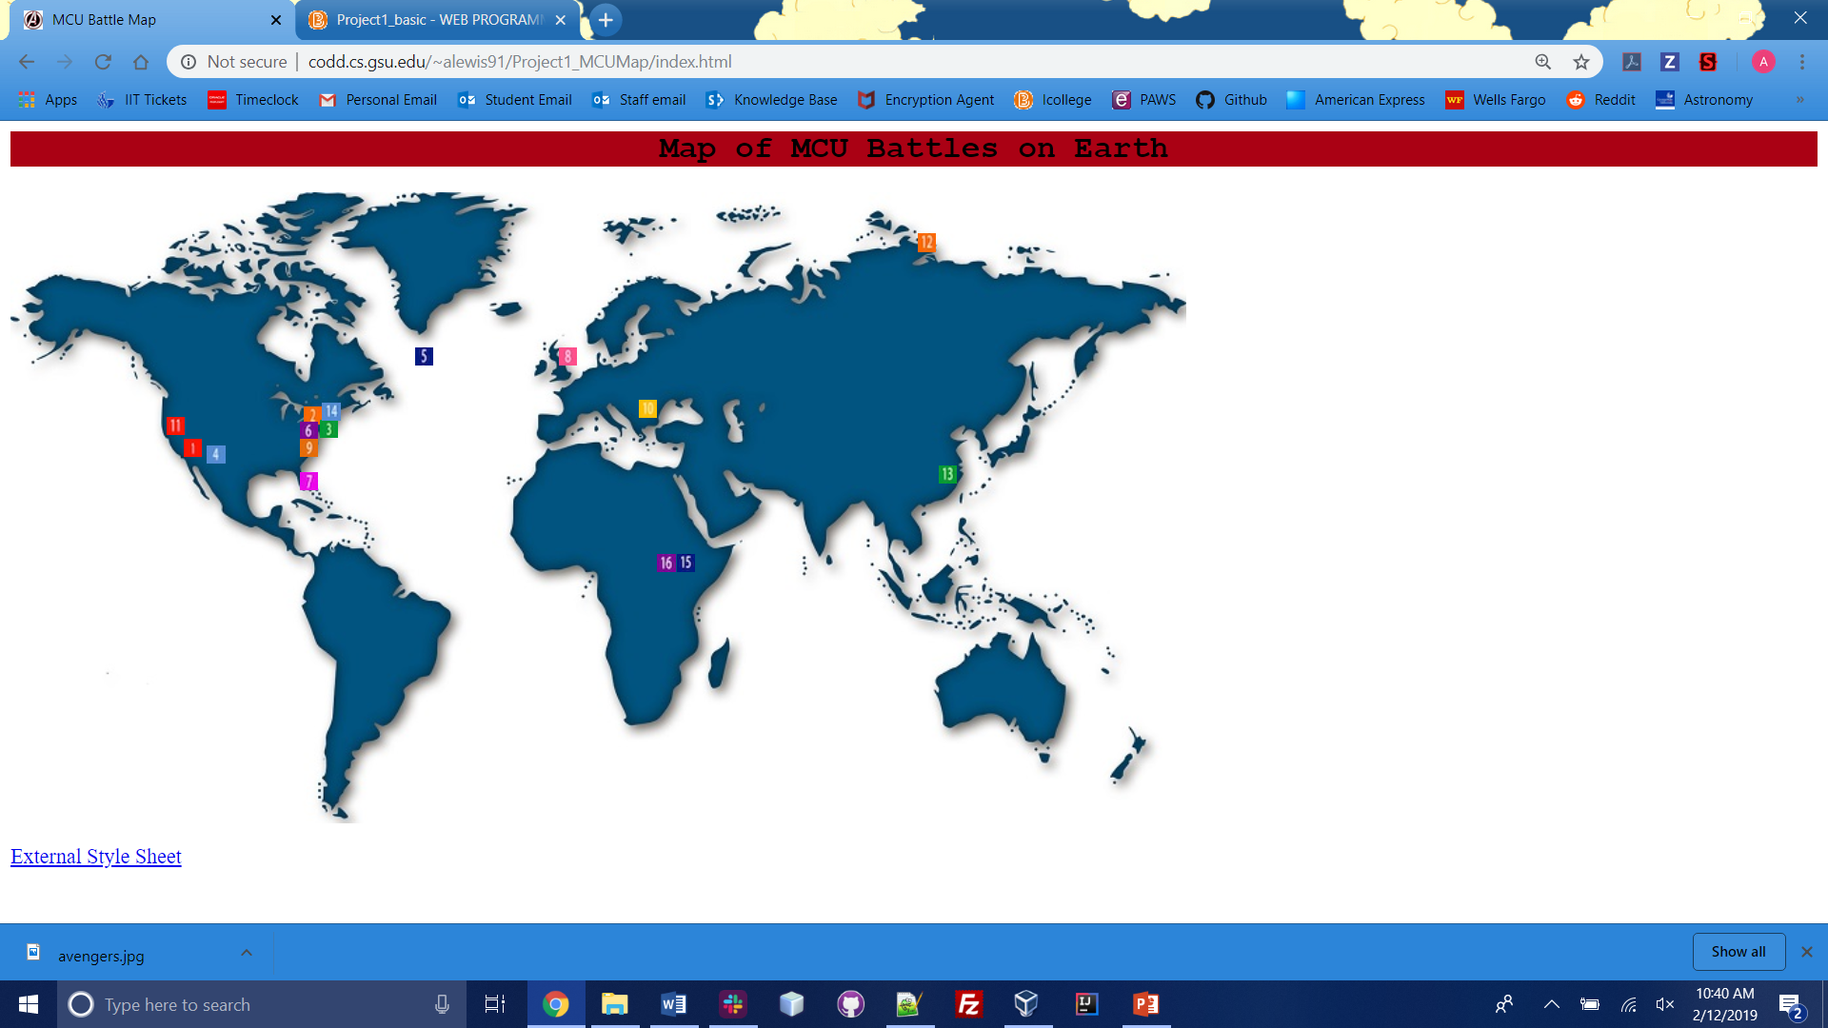

Slide 5
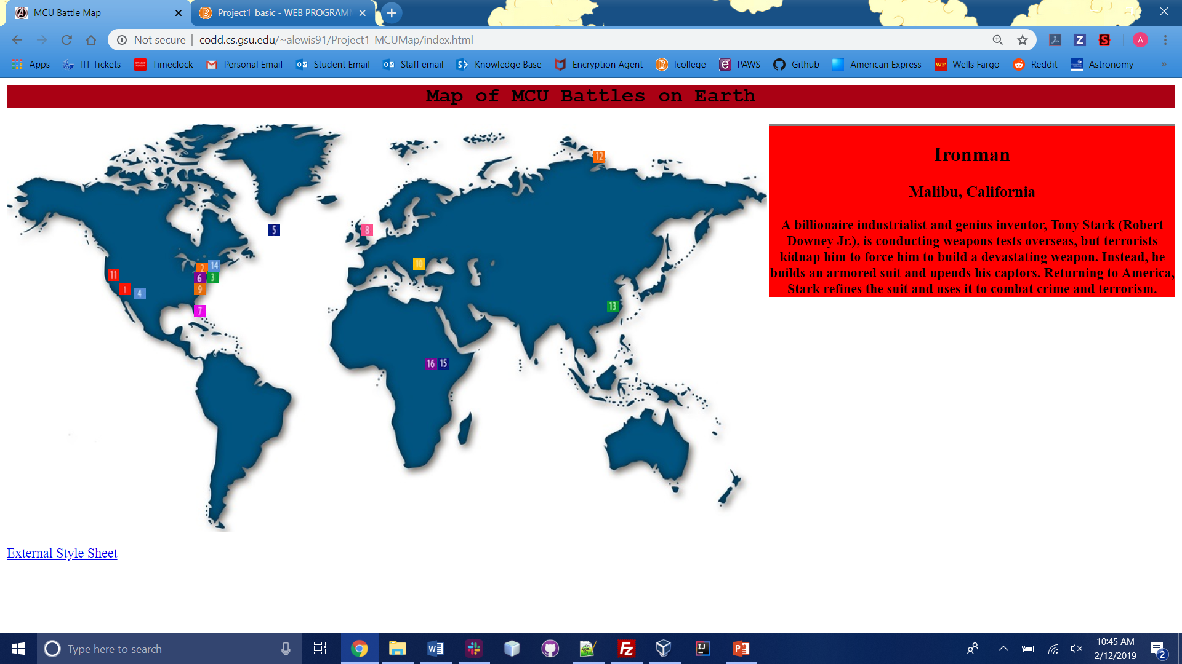

Slide 6
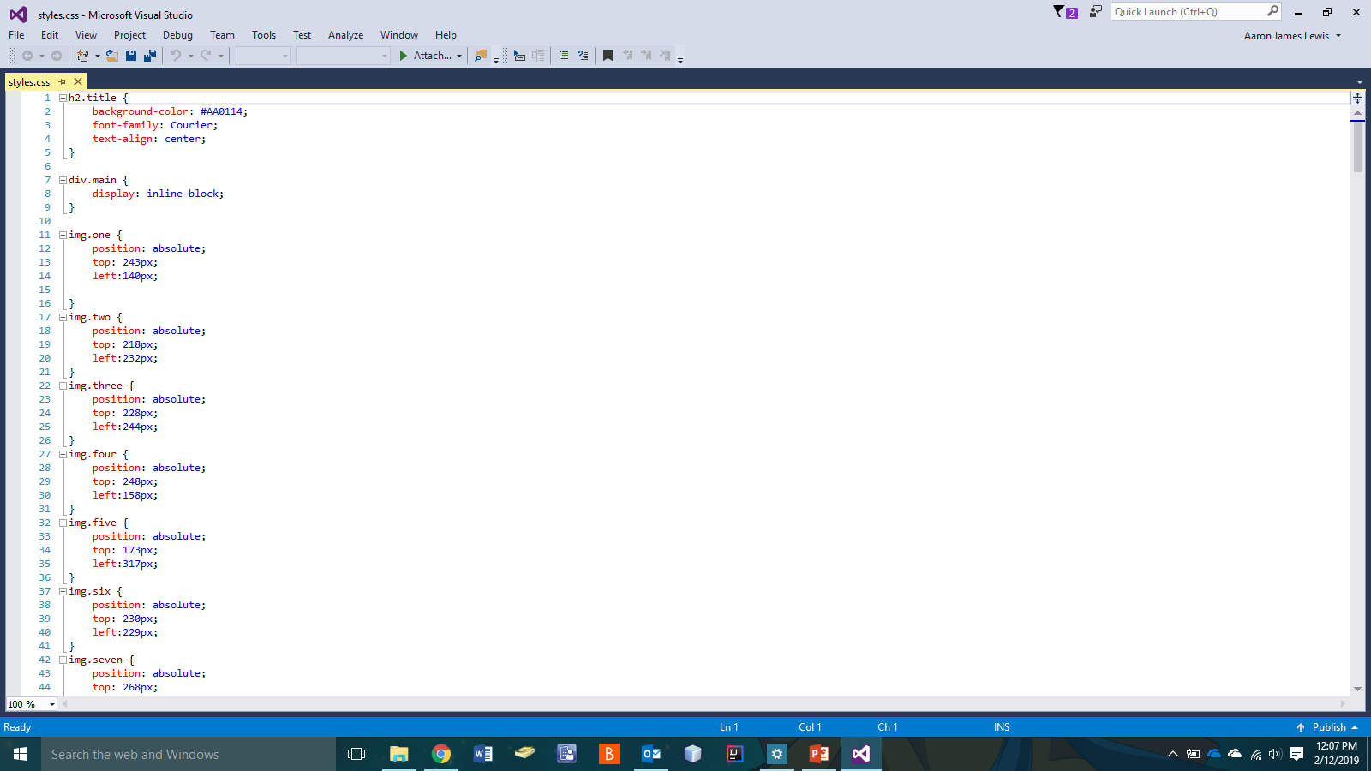
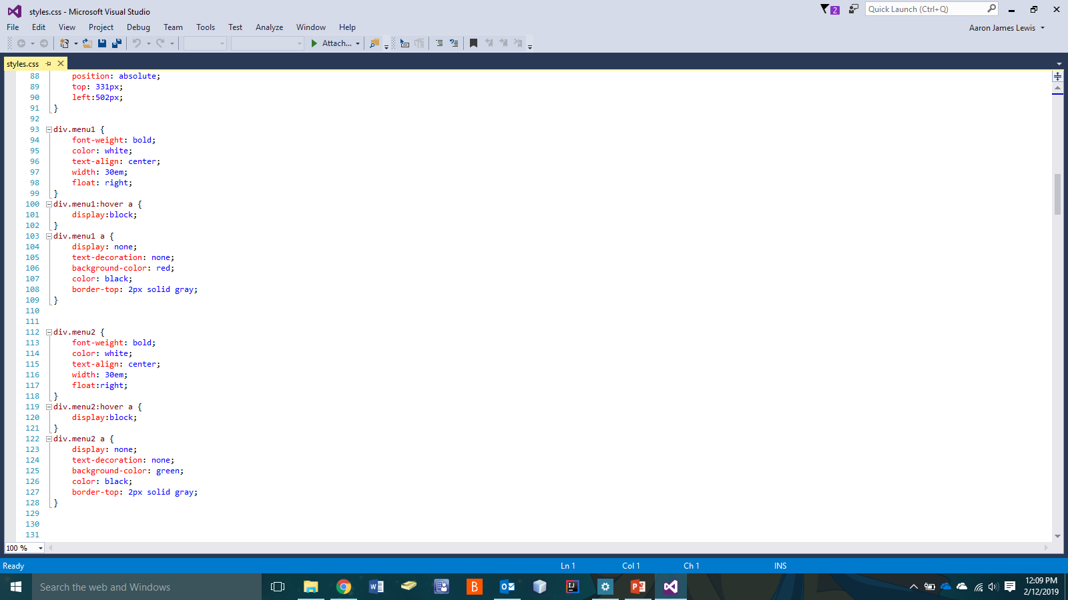
CSS Implementation

Slide 7
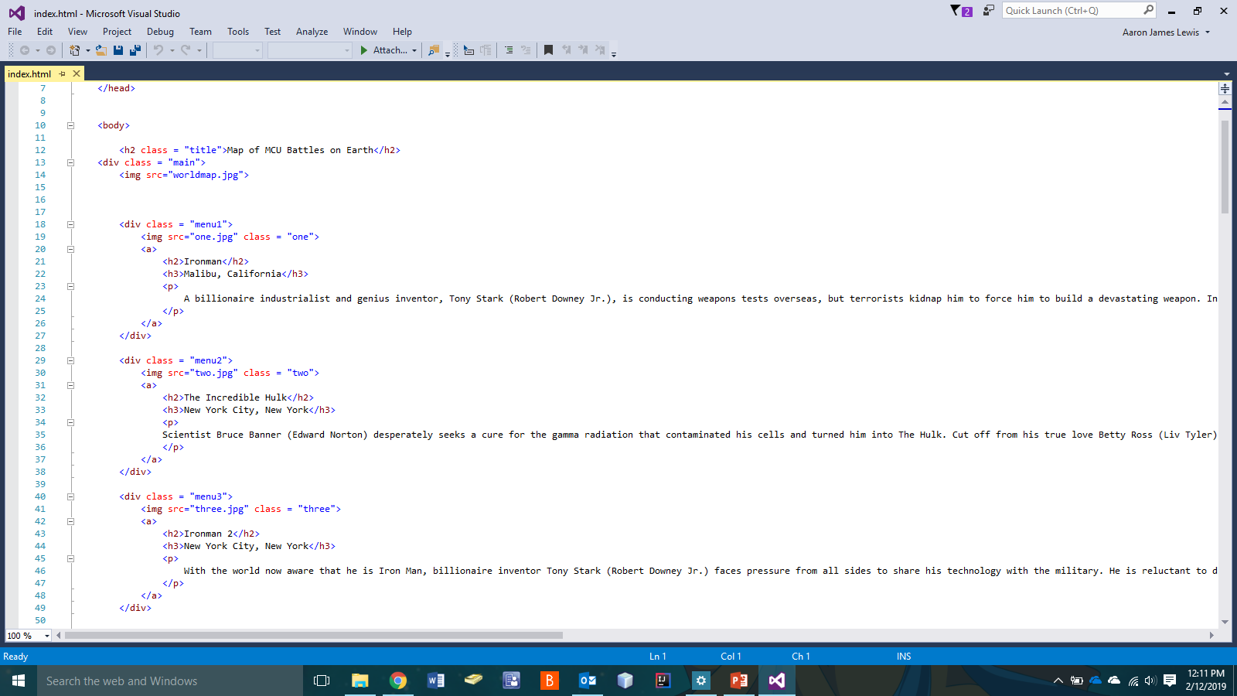
HTML Implementation

Slide 8

Any Questions?

